Slide 1
Chapter 6 – Architectural Design
Instructor
Dr. Sultan S. Alqahtani
ssalqahtani@imamu.edu.sa
Note: These are a slightly modified version of Ch6 slides available from the author’s site http://www.cs.st-andrews.ac.uk/~ifs/Books/SE9/

Slide 2
Topics covered
What is system architecture?
Architectural design decisions
Architectural views
Architectural patterns
Application architectures

Slide 3
Software architecture
The design process for identifying the sub-systems making up a system and the framework for sub-system control and communication is architectural design.
The output of this design process is a description of the software architecture.

Slide 4
Architecture vs. Design
The architecture of a system is its 'skeleton'. It's the highest level of abstraction of a system. What kind of data storage is present, how do modules interact with each other, what recovery systems are in place. Just like design patterns, there are architectural patterns: MVC, 3-tier layered design, etc.

Slide 5
Architecture vs. Design
Software design is about designing the individual modules / components. What are the responsibilities, functions, of module x? Of class Y? What can it do, and what not? What design patterns can be used?
So in short, Software architecture is more about the design of the entire system, while software design emphasizes on module / component / class level.

Slide 6
Architectural design
An early stage of the system design process.
Represents the link between specification and design processes.
Often carried out in parallel with some specification activities.
It involves identifying major system components and their communications.

Slide 7
Architectural design process
System structuring
The system is decomposed into several principal sub-systems and communications between these sub-systems are identified
Control modelling
A model of the control relationships between the different parts of the system is established
Modular decomposition
The identified sub-systems are decomposed into modules

Slide 8
Sub-systems and modules
A sub-system is a system in its own right whose operation is independent of the services provided by other sub-systems.
A module is a system component that provides services to other components but would not normally be considered as a separate system

Slide 9
Architectural patterns
Patterns are a means of representing, sharing and reusing knowledge.
An architectural pattern is a stylized description of good design practice, which has been tried and tested in different environments.

Slide 10
Architectural patterns
The Model-View-Control (MVC) pattern
Layered architecture pattern
Repository architecture pattern
Client-Server architecture pattern
Pipe and filter architecture pattern

Slide 11
The Model-View-Controller (MVC) pattern
Name | MVC (Model-View-Controller)
Description | Separates presentation and interaction from the system data. The system is structured into three logical components that interact with each other. The Model component manages the system data and associated operations on that data. The View component defines and manages how the data is presented to the user. The Controller component manages user interaction (e.g., key presses, mouse clicks, etc.) and passes these interactions to the View and the Model. See Figure 6.3.
Example | Figure 6.4 shows the architecture of a web-based application system organized using the MVC pattern.
When used | Used when there are multiple ways to view and interact with data. Also used when the future requirements for interaction and presentation of data are unknown.
Advantages | Allows the data to change independently of its representation and vice versa. Supports presentation of the same data in different ways with changes made in one representation shown in all of them.
Disadvantages | Can involve additional code and code complexity when the data model and interactions are simple.

Slide 12
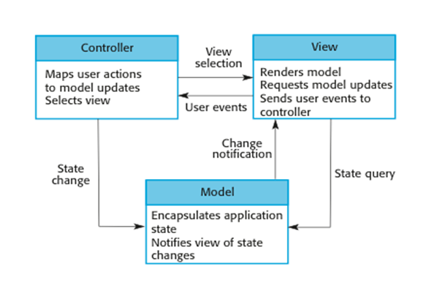
The organization of the Model-View-Controller

Slide 13
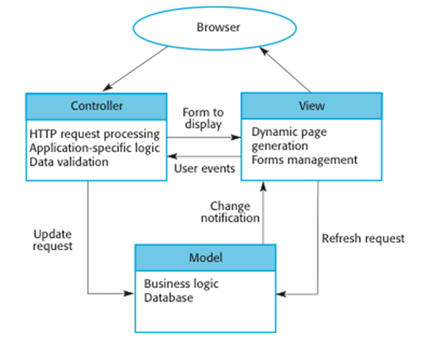
Web application architecture using the MVC pattern

Slide 14
The Layered architecture pattern
Name | Layered architecture
Description | Organizes the system into layers with related functionality associated with each layer. A layer provides services to the layer above it so the lowest-level layers represent core services that are likely to be used throughout the system. See Figure 6.6.
Example | A layered model of a system for sharing copyright documents held in different libraries, as shown in Figure 6.7.
When used | Used when building new facilities on top of existing systems; when the development is spread across several teams with each team responsibility for a layer of functionality; when there is a requirement for multi-level security.
Advantages | Allows replacement of entire layers so long as the interface is maintained. Redundant facilities (e.g., authentication) can be provided in each layer to increase the dependability of the system.
Disadvantages | In practice, providing a clean separation between layers is often difficult and a high-level layer may have to interact directly with lower-level layers rather than through the layer immediately below it. Performance can be a problem because of multiple levels of interpretation of a service request as it is processed at each layer.

Slide 15
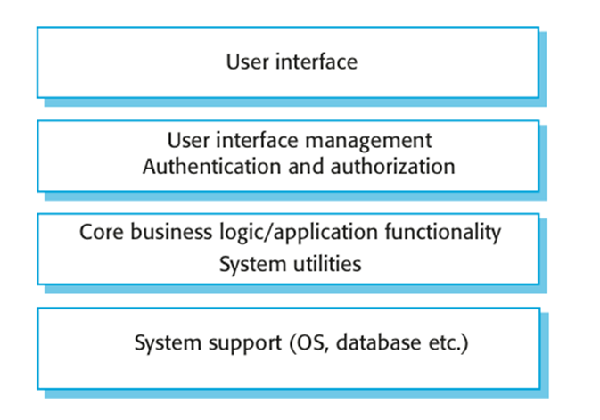
A generic layered architecture

Slide 16
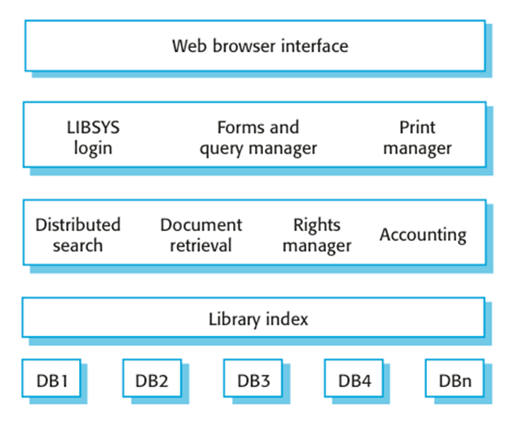
The architecture of the LIBSYS system

Slide 17
Key points
A software architecture is a description of how a software system is organized.
Architectural design decisions include decisions on the type of application, the distribution of the system, the architectural styles to be used.
Architectures may be documented from several different perspectives or viewssuch as a conceptual view, a logical view, a process view, and a development view.
Architectural patterns are a means of reusing knowledge about generic system architectures. They describe the architecture, explain when it may be used and describe its advantages and disadvantages.

Slide 18
Chapter 6 – Architectural Design
Lecture 2

Slide 19
The Repository pattern
Name | Repository
Description | All data in a system is managed in a central repository that is accessible to all system components. Components do not interact directly, only through the repository.
Example | Figure 6.9 is an example of an IDE where the components use a repository of system design information. Each software tool generates information which is then available for use by other tools.
When used | You should use this pattern when you have a system in which large volumes of information are generated that has to be stored for a long time. You may also use it in data-driven systems where the inclusion of data in the repository triggers an action or tool.
Advantages | Components can be independent—they do not need to know of the existence of other components. Changes made by one component can be propagated to all components. All data can be managed consistently (e.g., backups done at the same time) as it is all in one place.
Disadvantages | The repository is a single point of failure so problems in the repository affect the whole system. May be inefficiencies in organizing all communication through the repository. Distributing the repository across several computers may be difficult.

Slide 20
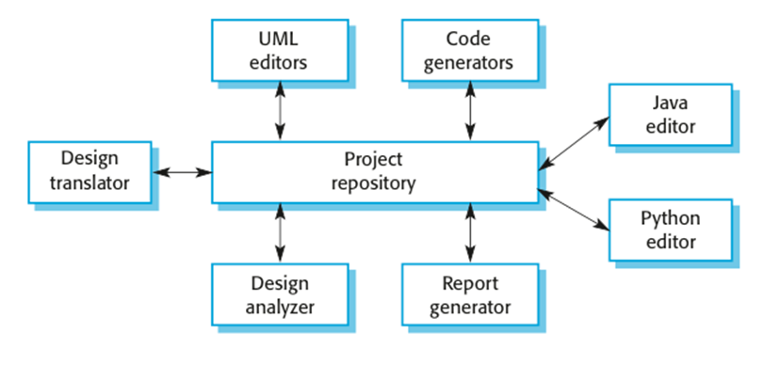
A repository architecture for an IDE

Slide 21
The Client–server pattern
Name | Client-server
Description | In a client–server architecture, the functionality of the system is organized into services, with each service delivered from a separate server. Clients are users of these services and access servers to make use of them.
Example | Figure 6.11 is an example of a film and video/DVD library organized as a client–server system.
When used | Used when data in a shared database has to be accessed from a range of locations. Because servers can be replicated, may also be used when the load on a system is variable.
Advantages | The principal advantage of this model is that servers can be distributed across a network. General functionality (e.g., a printing service) can be available to all clients and does not need to be implemented by all services.
Disadvantages | Each service is a single point of failure so susceptible to denial of service attacks or server failure. Performance may be unpredictable because it depends on the network as well as the system. May be management problems if servers are owned by different organizations.

Slide 22
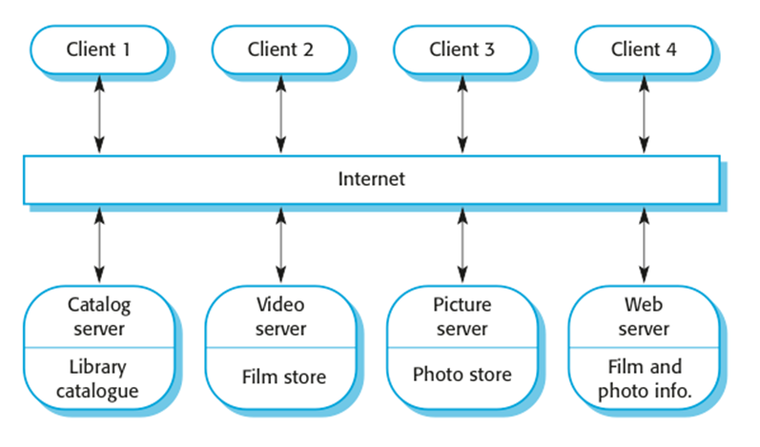
A client–server architecture for a film library

Slide 23
The pipe and filter pattern
Name | Pipe and filter
Description | The processing of the data in a system is organized so that each processing component (filter) is discrete and carries out one type of data transformation. The data flows (as in a pipe) from one component to another for processing.
Example | Figure 6.13 is an example of a pipe and filter system used for processing invoices.
When used | Commonly used in data processing applications (both batch- and transaction-based) where inputs are processed in separate stages to generate related outputs.
Advantages | Easy to understand and supports transformation reuse. Workflow style matches the structure of many business processes. Evolution by adding transformations is straightforward. Can be implemented as either a sequential or concurrent system.
Disadvantages | The format for data transfer has to be agreed upon between communicating transformations. Each transformation must parse its input and unparse its output to the agreed form. This increases system overhead and may mean that it is impossible to reuse functional transformations that use incompatible data structures.

Slide 24
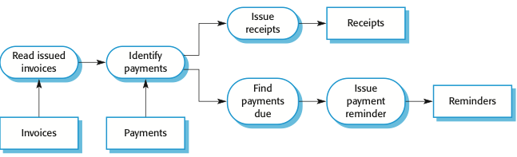
An example of the pipe and filter architecture

Slide 25
Reading ☺

Slide 26
Language processing systems
Accept a natural or artificial language as input and generate some other representation of that language.
May include an interpreter to act on the instructions in the language that is being processed.
Used in situations where the easiest way to solve a problem is to describe an algorithm or describe the system data
Meta-case tools process tool descriptions, method rules, etc and generate tools.

Slide 27
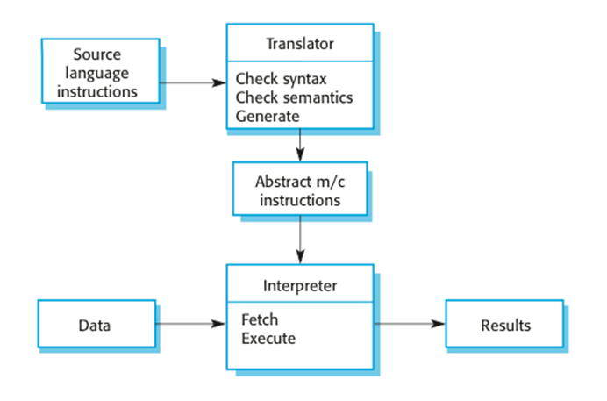
The architecture of a language processing system

Slide 28
Compiler components
A lexical analyzer, which takes input language tokens and converts them to an internal form.
A symbol table, which holds information about the names of entities (variables, class names, object names, etc.) used in the text that is being translated.
A syntax analyzer, which checks the syntax of the language being translated.
A syntax tree, which is an internal structure representing the program being compiled.

Slide 29
Compiler components
A semantic analyzer that uses information from the syntax tree and the symbol table to check the semantic correctness of the input language text.
A code generator that ‘walks’ the syntax tree and generates abstract machine code.

Slide 30
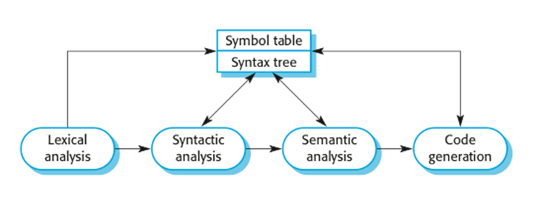
A pipe and filter compiler architecture

Slide 31
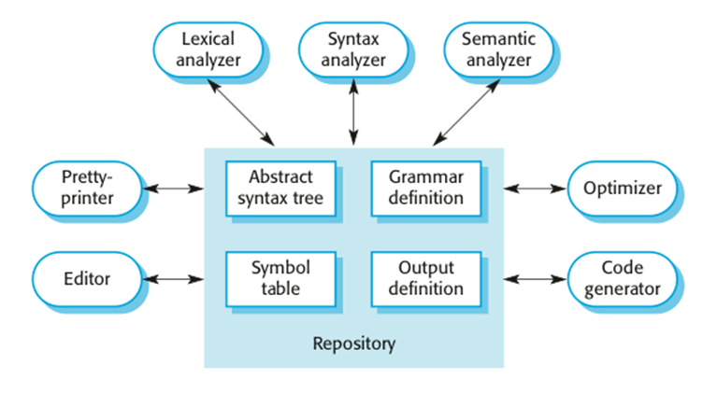
A repository architecture for a language processing system

Slide 32
Key points
Models of application systems architectures help us understand and compare applications, validate application system designs and assess large-scale components for reuse.
Transaction processing systems are interactive systems that allow information in a database to be remotely accessed and modified by a number of users.
Language processing systems are used to translate texts from one language into another and to carry out the instructions specified in the input language. They include a translator and an abstract machine that executes the generated language.

